Slide 1
Simple Review
Heap Sort
  Heaps
  MAX-HEAPIFY
  BUILD-MAX-HEAP
  HEAPSORT
Priority Queues
  MAXIMUM(S)
  EXTRACT-MAX(S)
  INCREASE-KEY(S,x,k)
  INSERT(S, x)
  Applications

Slide 2
Design and Analysis of Algorithms
Quicksort (Ch7)

Slide 3
Design and Analysis of Algorithms
Quicksort
Topics:
Quicksort
Randomized quicksort algorithms

Slide 4
Randomized algorithm
Randomized algorithms: algorithms that flip coins
--Applications
>>Quicksort
>>Discovering common motif in DNA sequence in computational biology
Algorithms that make random decisions
That is:
--Can generate a random number x from some range {1,r}
--Make decisions based on the value of x
Why would it make sense?
Notes:
Motif：主题, 主旨, 动机, 图形

Slide 5

Two cups, one coin
If you always choose a fixed cup, the adversary will put the coin in the other one, so the expected payoff=$0
If you choose a random cup, the expected payoff=$0.5
Notes:
Adversary：敌手, 对手

Slide 6
Randomized algorithm
Two basic types:
--Typically fast (but sometimes slow): Las Vegas
--Typically correct (but sometimes output garbage): Monte Carlo
The probabilities are defined by the random numbers of the algorithm! (not by random choices of the problem instances)

Slide 7
Quicksort
Efficient sorting algorithm
--Proposed by C.A.R. Hoare in 1962
--Divide-and-Conquer algorithm
--Sorts “in place” (like insertion sort, but not like merge sort)
--Very practical (with tuning)
--Can be viewed as a randomized Las Vegas algorithm
--Worst-case running time: Θ(n²)
--Expected running time: Θ(nlogn)
--Constant hidden in Θ(nlogn) are small.

Slide 8
Divide and Conquer
Quicksort an n-element array:
--Divide: Partition the array into two subarrays around a pivot x such that elements in lower subarray≤x≤ elements in upper subarray
--Conquer: Recursively sort the subarrays.
--Combine: Trivial.
Key: Linear-time partitioning subroutine.
Notes:
枢轴, 支点, (讨论的)中心点, 重点

Slide 9
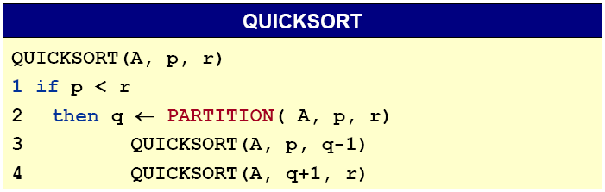
Divide and Conquer
Initial call Quicksort(A, 1, n)

Slide 10
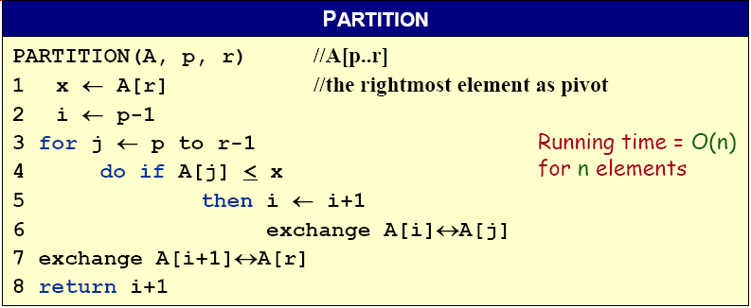
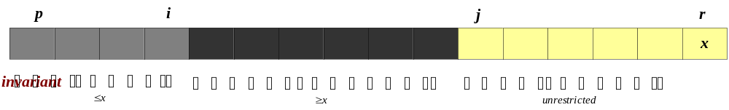
Partitioning subroutine
A[p,…,i]:known to be ≤ pivot
A[j…r]:not yet examined
A[i+1,…,j-1]:known to be > pivot
A[r]:pivot
Notes:
Pivot：枢轴, 支点, (讨论的)中心点, 重点

Slide 11










Example of Partitioning
The operation of Partition on a sample array. Lightly shaded array elements are all with values no greater than x (the pivot). Heavily shaded array elements are all with values greater than x.
Notes:
由于A[i]和A[j]的交换，其中间通常隔了若干其它元素，因此可能导致不稳定
如：2 8 7 7 1 5 6 4，第一趟Partition就会将两个7的位置互换，而后续并不再换回来了

Slide 12
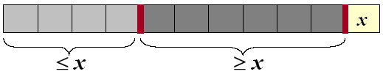
Analysis of quicksort
Assume all input elements are distinct.
In practice, there are better partitioning algorithms for when duplicate input elements may exist.
Let T(n) = worst-case running time on an array of n elements.

Slide 13
Worst-case of quicksort
Input sorted or reverse sorted.
Partition around min or max element.
One side of partition always has no elements.
T(n) = T(n - 1) + T(0) + Θ(n)
= T(n - 1) + Θ(1) + Θ(n)
= T(n - 1) + Θ(n)
= Θ(n²) (Arithmetic series)

Slide 14
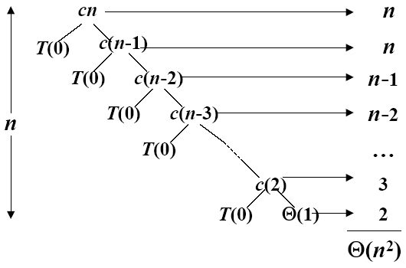
Worst-case recursive tree
T(n) = T(n - 1) + T(0) + Θ(n)
A recursion tree for QUICKSORT in which the Partition procedure always puts only a single element on one side of the partition (the worst case). The resulting running time is Θ(n²)

Slide 15
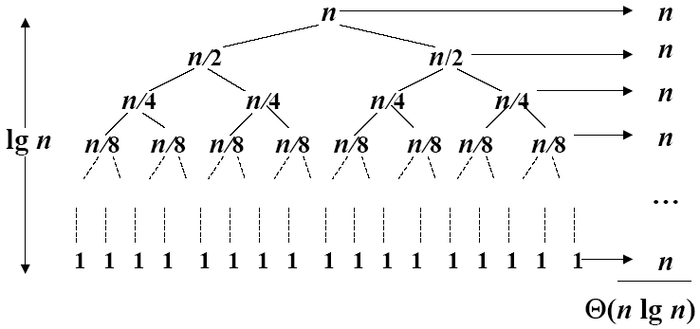
Best Case Partitioning
Θ(nlgn)
A recursion tree for QUICKSORT in which the Partition always balances the two sides of the partition equally (the best case). The resulting running time is Θ(nlgn)

Slide 16
Best-case analysis
If we’re lucky, PARTITION splits the array evenly:
--T(n) = 2T(n/2) + Θ(n) = Θ(nlogn).
What if the split is always 1/10:9/10?
--T(n) ≤ T(9n/10) + T(n/10) + Θ(n)
--What is the solution to this recurrence?
Notes:
Evenly：均匀地

Slide 17
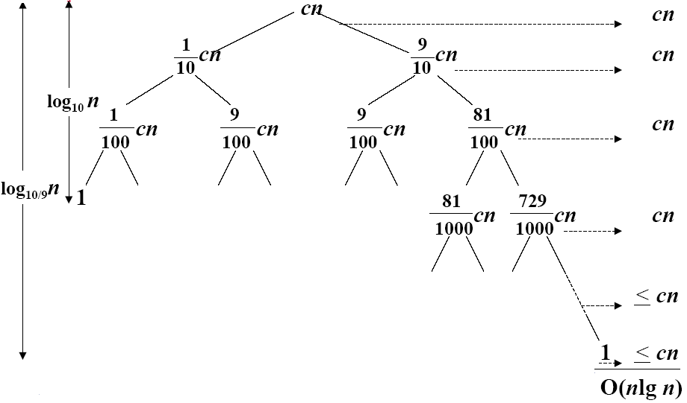
A Recursion tree
Worst case Θ(n²), why we prefer Quicksort to Mergesort
A recursion tree for QUICKSORT in which PARTITION always produces a 9-to-1 split, yielding a running time of O(n lgn)

Slide 18
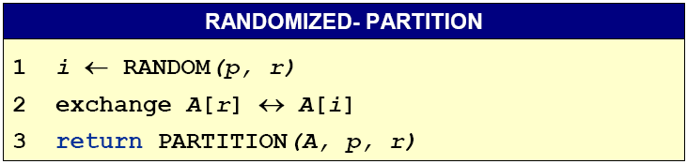
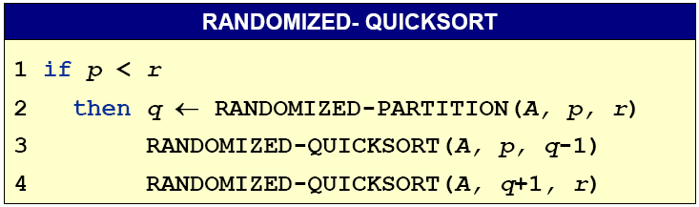
Randomize-Partitioning

Slide 19
Randomized quicksort
Partition around a random element, i.e., around A[t], where t chosen uniformly at random from {p…r}
expected time is O(n lgn)
Notes:
Uniformly：一律地

Slide 20
Quicksort VS. Mergesort
Which is better?
Test environment:
  IBM370/158
  Programming in PL/1
  Input consists of random integers range in (0, 10000)
n 1000 1500 2000 2500 3000 3500 4000 4500
MERGESORT 500 750 1050 1400 1650 2000 2250 2650
QUICKSORT 400 600 850 1050 1300 1550 1800 2050
n 5000 5500 6000 6500 7000 7500 8000 8500
MERGESORT 2900 3450 3500 3850 4250 4550 4950 5200
QUICKSORT 2300 2650 2800 3000 3350 3700 3900 4100

Slide 21
Homework
7.2-2

